Slide 1

LOW COST - 1

Slide 2
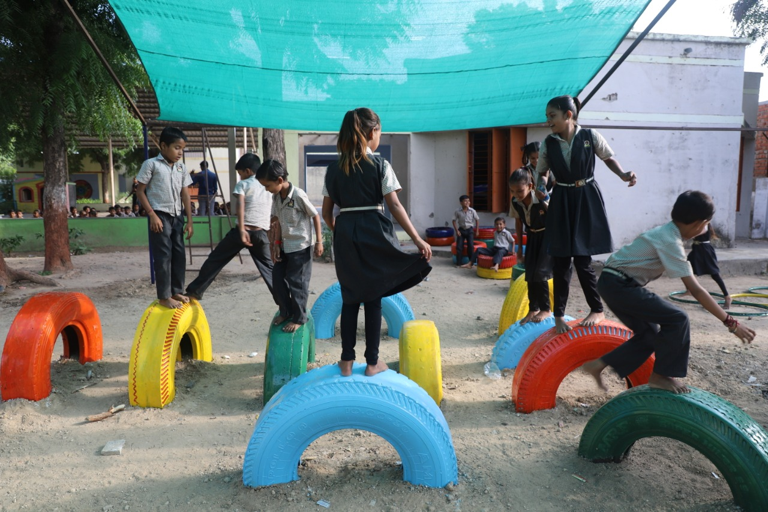
STEPPING STONES
An element, designed to enhance the creativity of a child, as tyres are placed at varied levels, they can fundamentally jump from one level to the other, what more they would fabricate around this, would be a surprise.

Slide 3
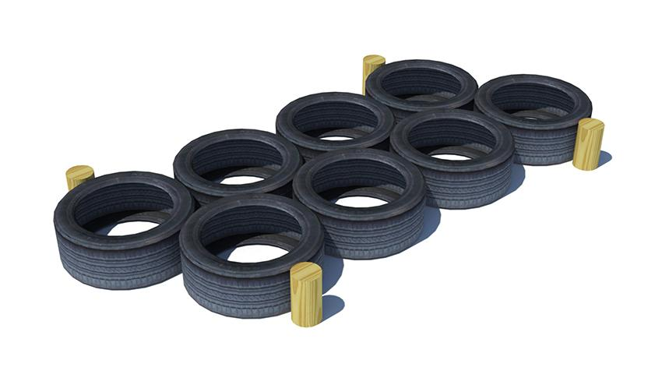
TYRE HOP
Hopscotch is an activity where kids would use both their legs and two sides of their brains accordingly, it would also be a fun exercise for adults.

Slide 4
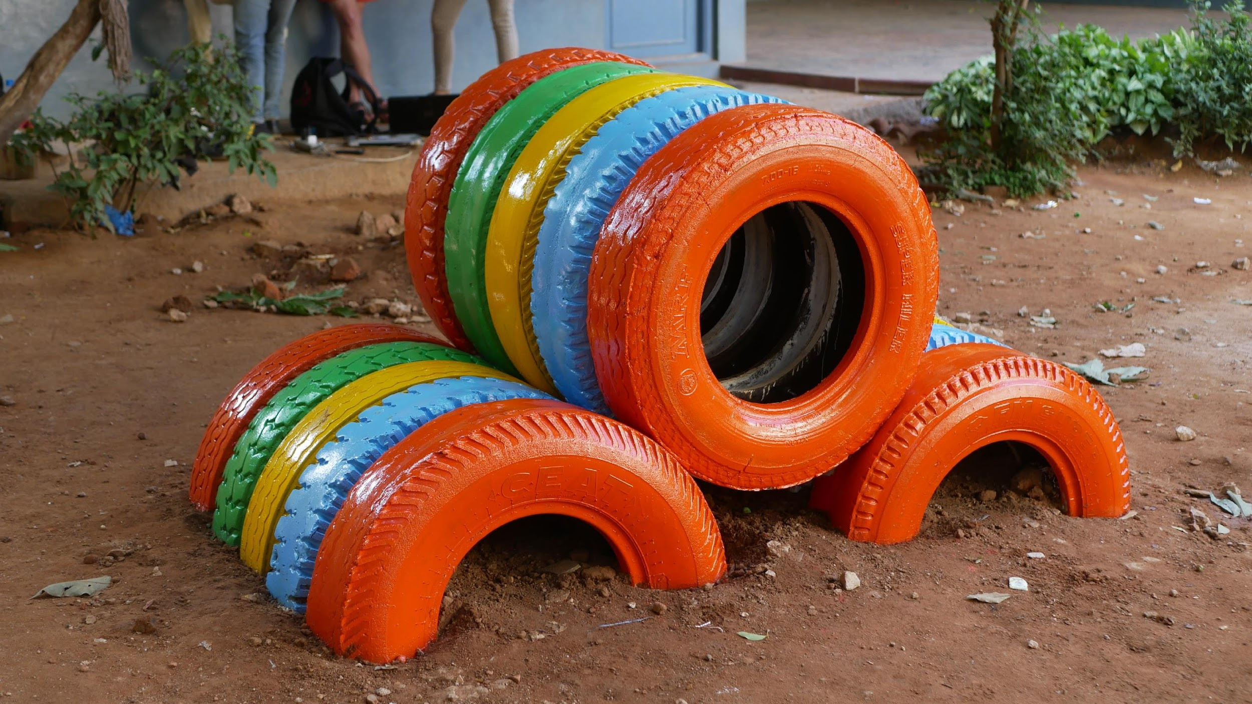
TYRE Hurdle
It is a great play element for kids to crawl, jump and pass through. It helps to create a rhythm and increase their speed.

Slide 5
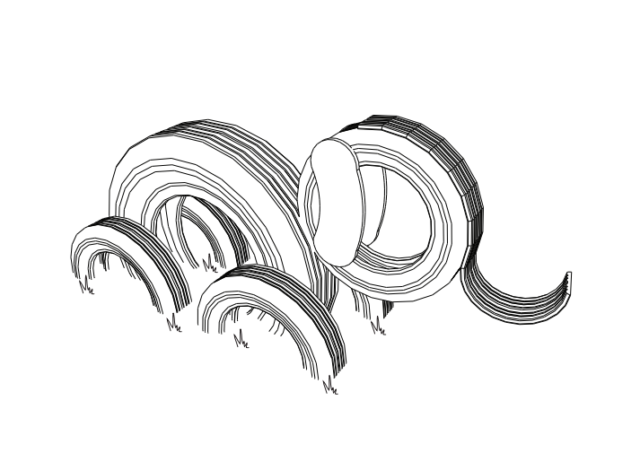
How do we perceive an Elephant
Elephant
Number of Users : 2-3

Slide 6
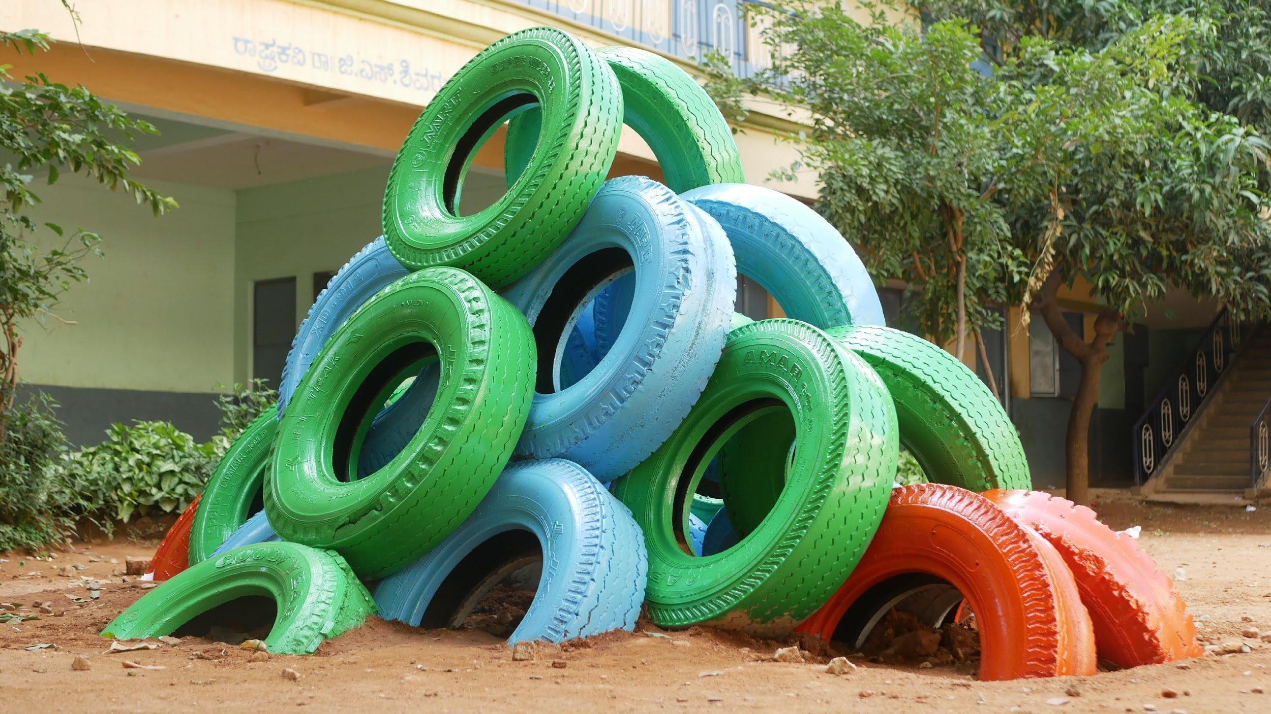
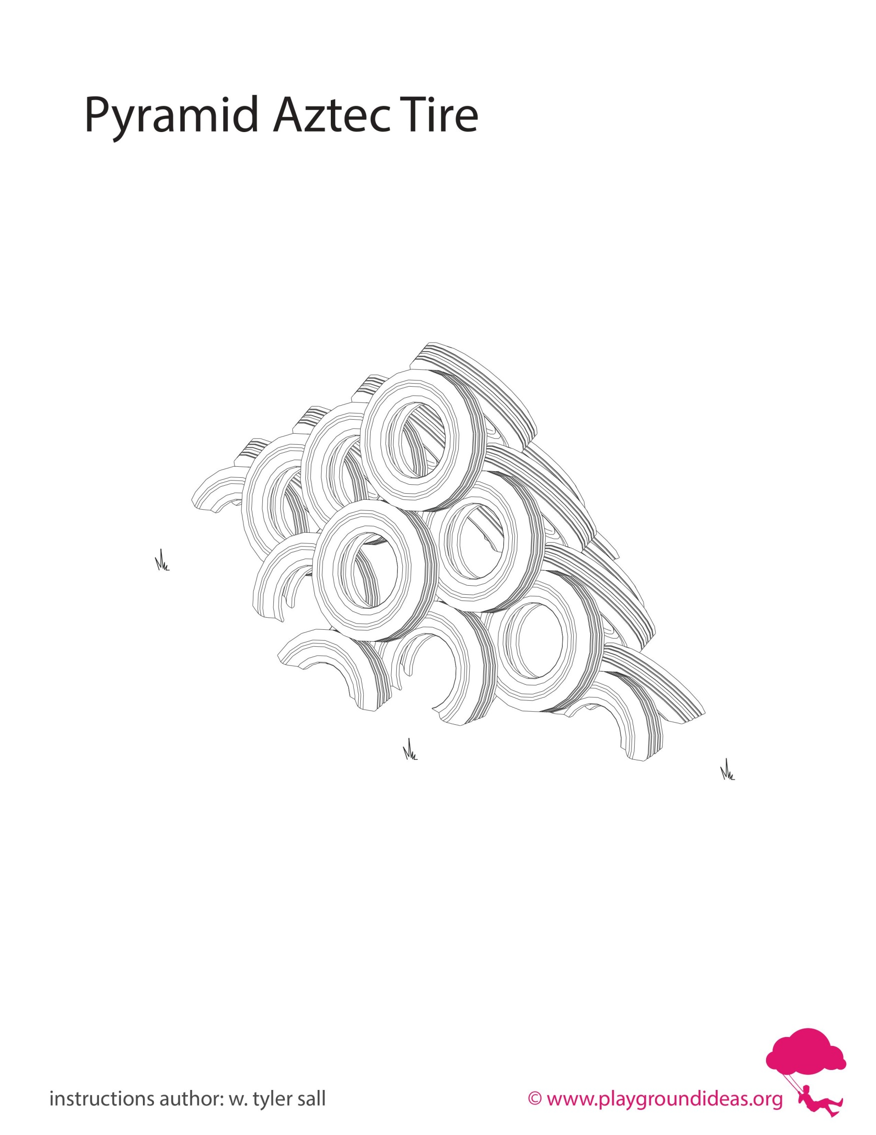
How do we perceive a pyramid?
AZTEC PYRAMID
Number of Users : 8-10

Slide 7
How do we perceive a pyramid?
AZTEC PYRAMID
Number of Users : 8-10

Slide 8
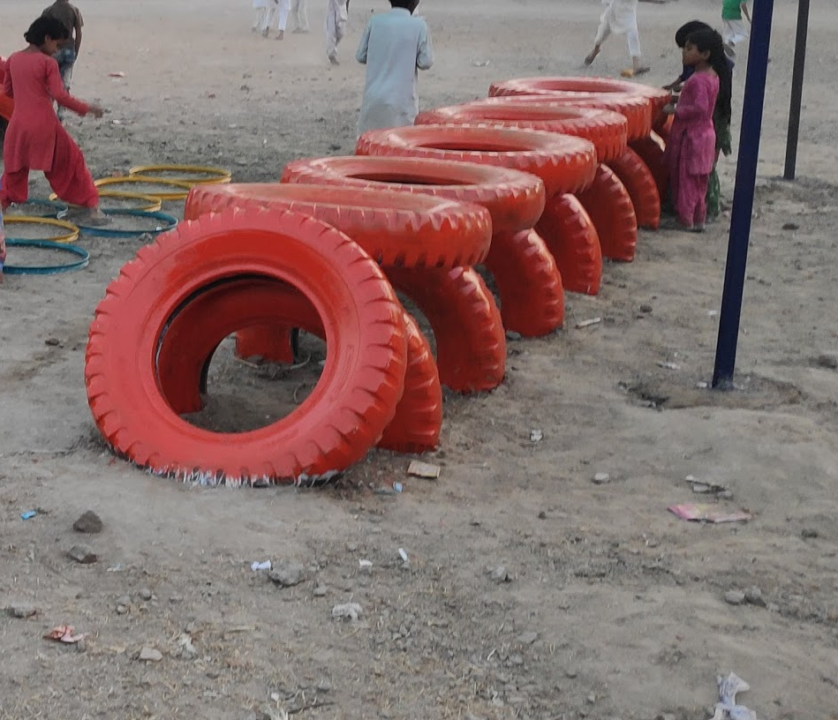
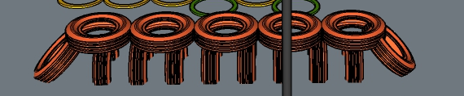

How do we perceive wobble bridge ?
WOBBLE BRIDGE
Number of Users : 7-8
Material: Tyres

